Slide 1

WQD 7003 Data Analytics
CHAPTER 4 – DATA PREPROCESSING – PART 2
Saw Shier Nee, Hema Subramaniam & Aznul Qalid Md Sabri
sawsn@um.edu.my , hema@um.edu.my, aznulqalid@um.edu.my
Dept. of AI, Fac. of Computer Science and IT, University of Malaya
Dept. of SE, Fac. of Computer Science and IT, Universiti Malaya

Slide 2

Outline
Why preprocess the data?
Descriptive data summarization
Data cleaning
Data integration and transformation
Data reduction
Discretization and concept hierarchy generation
Summary

Slide 3
Learning Outcomes
At the end of this lecture, student will be able to:
To explore the appropriate technique for data pre-processing

Slide 4
Data Integration
Data Integration
Combines data from multiple sources into a coherent store
Identify real world entities from multiple data sources, e.g., Bill Clinton = William Clinton
Schema
Integrate metadata from different sources
e.g., A.cust-id ≡ B.cust-#
Detecting and resolving data value conflicts
For the same real world entity, attribute values from different sources are different
Possible reasons: different representations, different scales, e.g., metric vs. British units

Slide 5
Handling Redundancy in Data Integration
Data Integration
Redundant attributes may be able to be detected by correlation analysis
Object Identification - The same attribute or object may have different names in different databases
Derivable Data - One attribute may be a “derived” attribute in another table, e.g., annual revenue

Slide 6
Correlation
Correlation: The degree of relationship between the variables under consideration is measure through the correlation analysis.
The measure of correlation called the correlation coefficient
The degree of relationship is expressed by coefficient which range from correlation ( -1 ≤ r ≤ +1)
The correlation analysis enable us to have an idea about the degree & direction of the relationship between the two variables under study.

Slide 7
Correlation and Causations
Causation means cause & effect relation.
Correlation denotes the interdependency among the variables for correlating two phenomenon, it is essential that the two phenomenon should have cause-effect relationship & if such relationship does not exist then the two phenomenon can not be correlated.
If two variables vary in such a way that movement in one are accompanied by movement in other, these variables are called cause and effect relationship.
Causation always implies correlation but correlation does not necessarily imply causation.

Slide 8
Correlation and Cautions
Correlation
Positive Correlation
Negative Correlation

Slide 9
Correlation and Cautions
Positive Correlation: The correlation is said to be positive correlation if the values of two variables changing with same direction.
Ex. Height & weight, temperature & ice cream sales.
Negative Correlation: The correlation is said to be negative correlation when the values of variables change with opposite direction.
Ex. Product supply, price.

Slide 10
Direction of Correlation
Positive relationship – Variables change in the same direction.
As X is increasing, Y is increasing
As X is decreasing, Y is decreasing
E.g., As height increases, so does weight.
Negative relationship – Variables change in opposite directions.
As X is increasing, Y is decreasing
As X is decreasing, Y is increasing
E.g., As TV time increases, grades decrease
Indicated by
sign; (+) or (-).

Slide 11
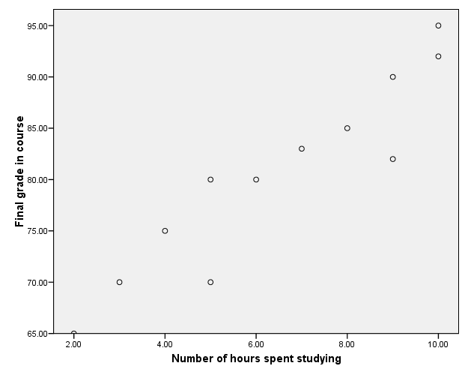
Positive Relationship

Slide 12
Negative Relationship
Reliability
Age of Car

Slide 13
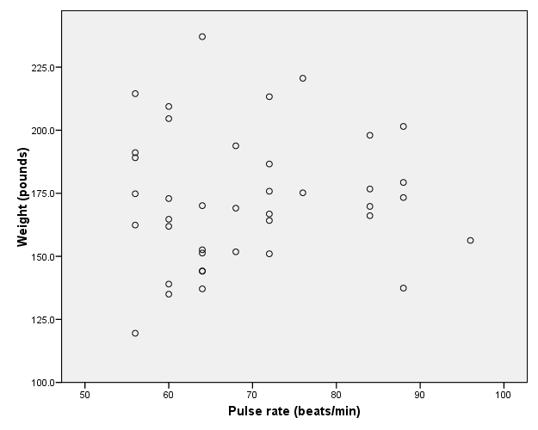
No relation

Slide 14
Correlation
The value of r ranges between ( -1) and ( +1)
The value of r denotes the strength of the association as illustrated by the following diagram.
strong
intermediate
weak
weak
intermediate
strong
-1
-0.75
-0.25
0
0.25
0.75
1
indirect
Direct
perfect correlation
perfect correlation
no relation

Slide 15
More Examples
Positive relationships
water consumption and temperature.
study time and grades
Negative relationships:
alcohol consumption and driving ability.
Price & product supply

Slide 16
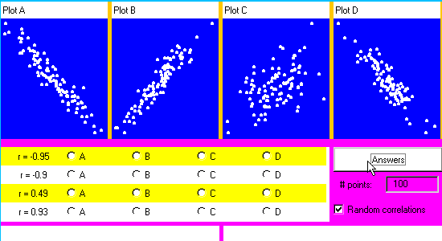
Exercise

Slide 17
Data Transformation
Smoothing – remove noise from data
Aggregation - summarization
Generalization – concept hierarchy climbing
Normalization – scale to fall within the small and specified range
Attribute/feature construction – new attribute constructed from the given ones

Slide 18
Min Max Normalization
Marks | Min-Max Normalization
8 | 0
10 | 0.16
15 | 0.25
20 | 1

Slide 19
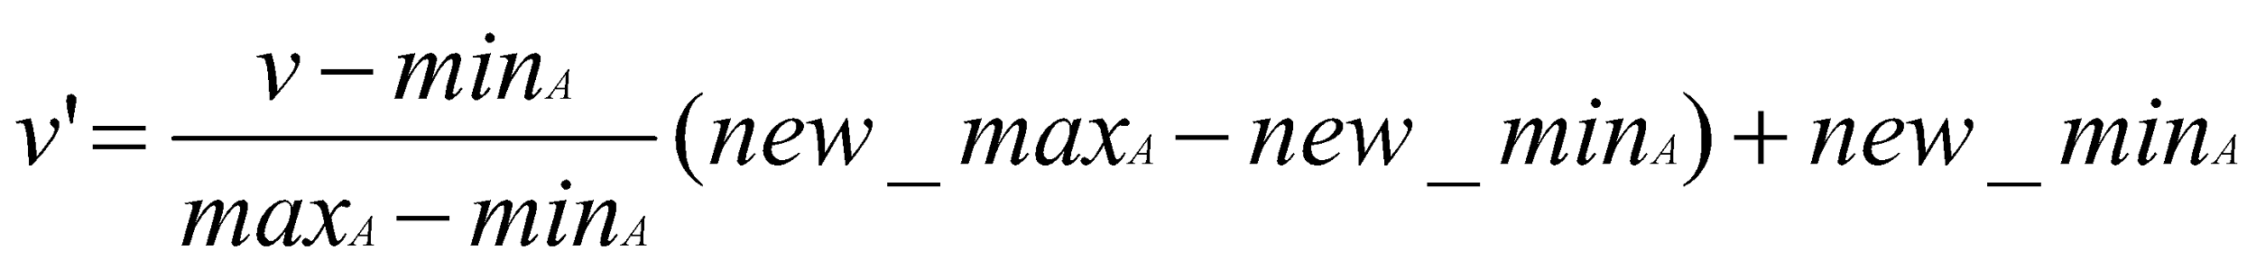
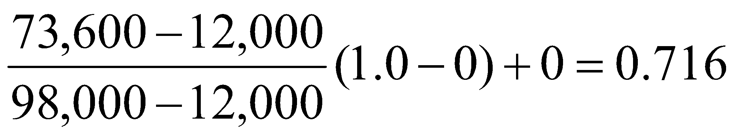

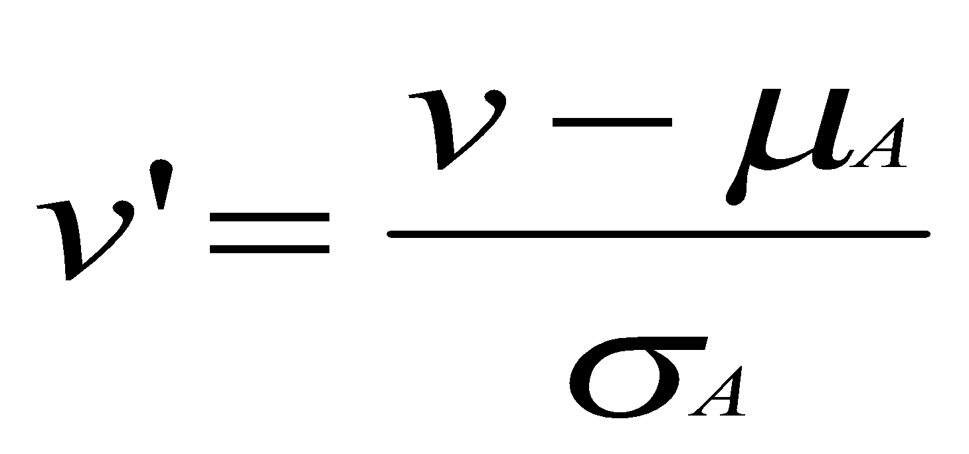
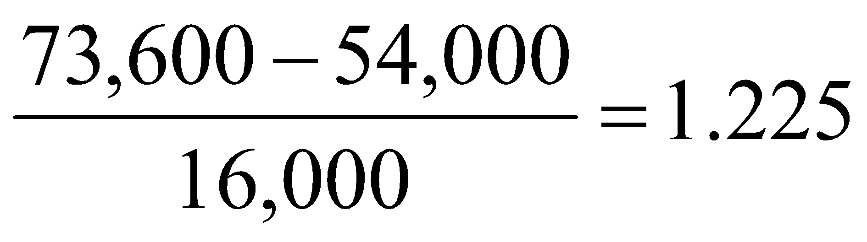
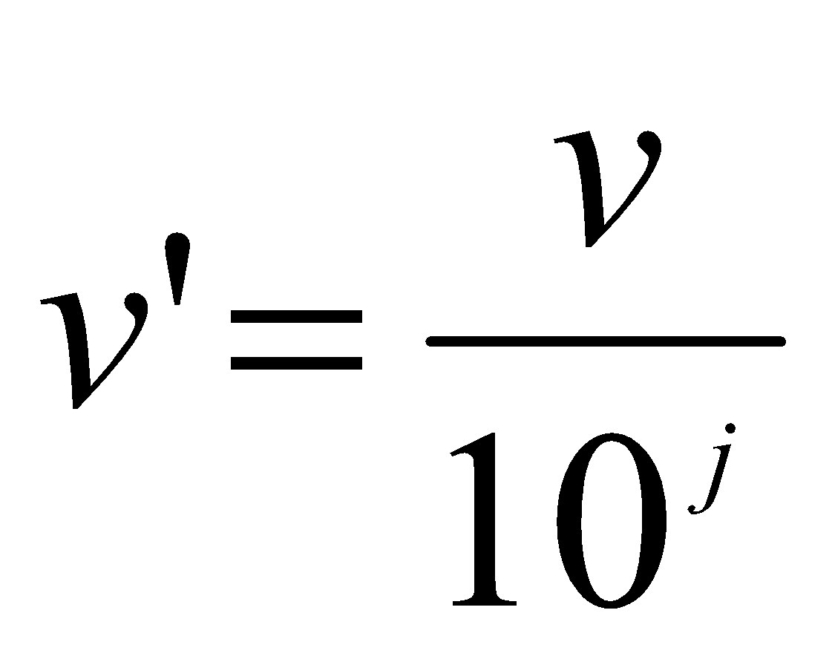
Data Transformation: Normalization
Min-max normalization: to [new_min_{A}, new_max_{A}]
Ex. Let income range $12,000 to $98,000 normalized to [0.0, 1.0]. Then $73,600 is mapped to
Z-score normalization (μ: mean, σ: standard deviation):
Ex. Let μ = 54,000, σ = 16,000. Then
Normalization by decimal scaling
Where j is the smallest integer such that Max(|ν’|) < 1

Slide 20
z-scores
When a set of data values are normally distributed, we can standardize each score by converting it into a z-score.
z-scores make it easier to compare data values measured on different scales.

Slide 21
z-scores
A z-score reflects how many standard deviations above or below the mean a raw score is.
The z-score is positive if the data value lies above the mean and negative if the data value lies below the mean.

Slide 22
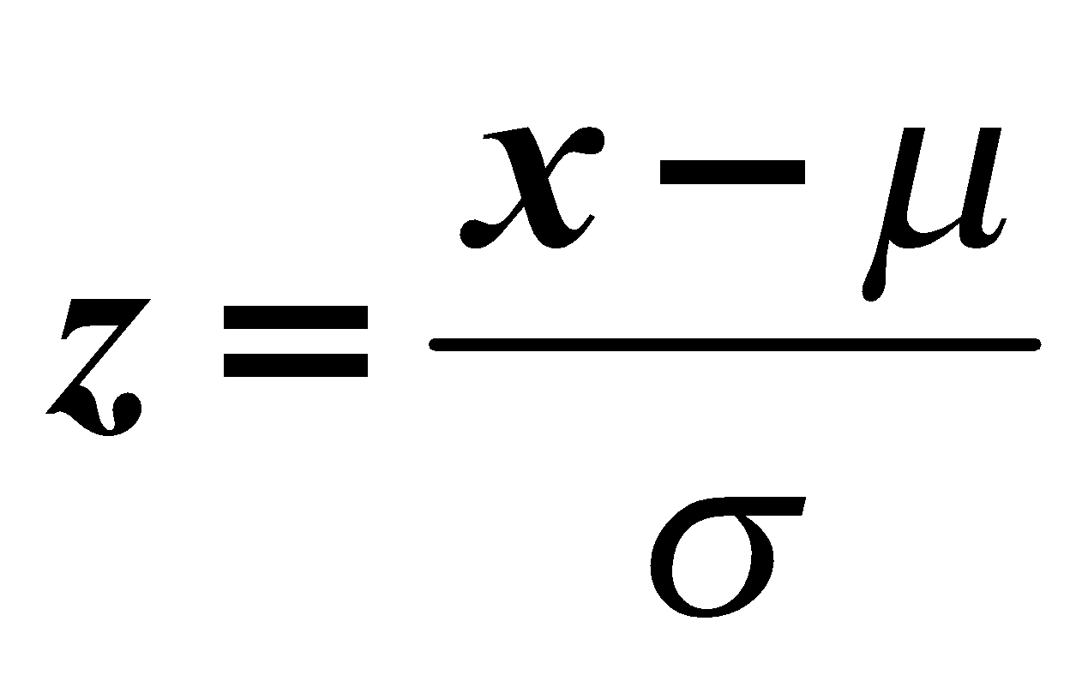


z-score formula
Where x represents an element of the data set, the mean is represented by and standard deviation by .

Slide 23
Analyzing the data
Suppose SAT scores among college students are normally distributed with a mean of 500 and a standard deviation of 100. If a student scores a 700, what would be her z-score?
Answer Now

Slide 24
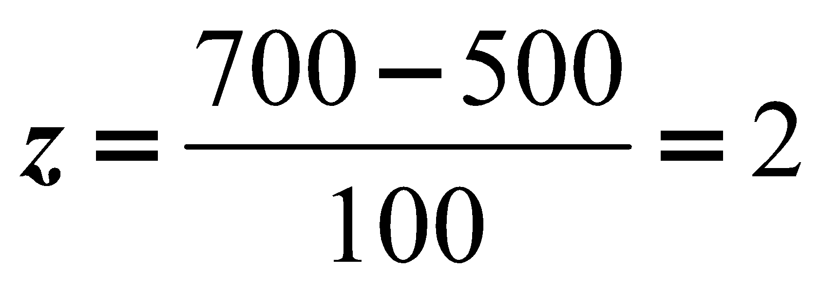
Analyzing the data
Suppose SAT scores among college students are normally distributed with a mean of 500 and a standard deviation of 100. If a student scores a 700, what would be her z-score?
Her z-score would be 2 which means her score is two standard deviations above the mean.

Slide 25
Analyzing the data
A set of math test scores has a mean of 70 and a standard deviation of 8.
A set of English test scores has a mean of 74 and a standard deviation of 16.
For which test would a score of 78 have a higher standing?
Answer Now

Slide 26
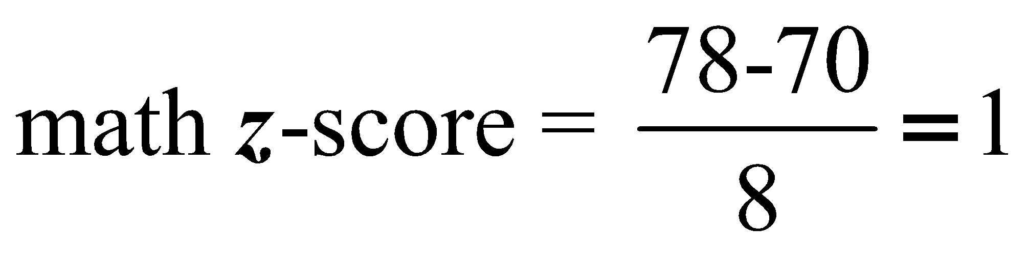
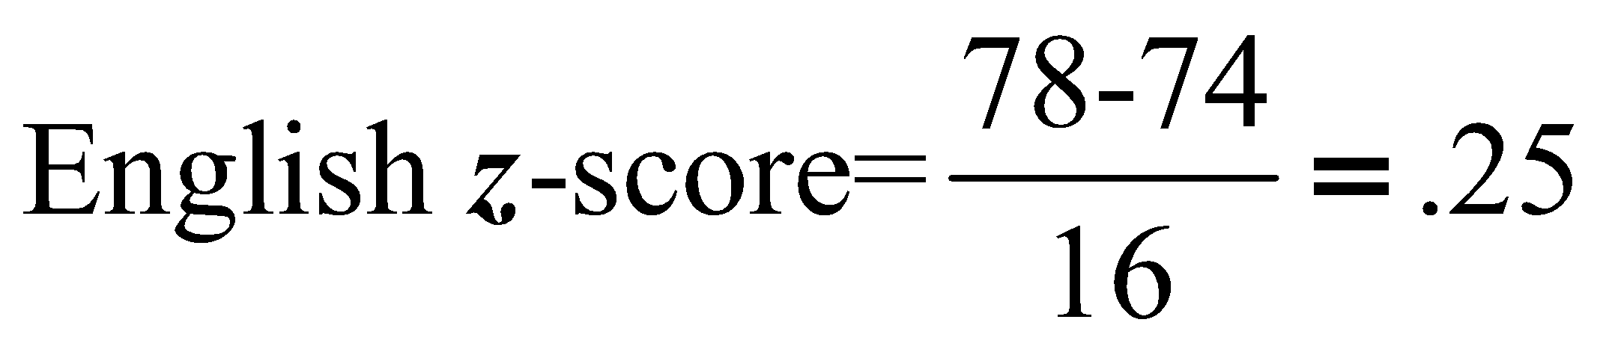
Analyzing the data
A set of math test scores has a mean of 70 and a standard deviation of 8.
A set of English test scores has a mean of 74 and a standard deviation of 16. For which test would a score of 78 have a higher standing?
To solve: Find the z-score for each test.
The math score would have the highest standing since it is 1 standard deviation above the mean while the English score is only .25 standard deviation above the mean.

Slide 27
Analyzing the data
What will be the miles per gallon for a Toyota Camry when the average mpg is 23, it has a z value of 1.5 and a standard deviation of 2?
Answer Now

Slide 28
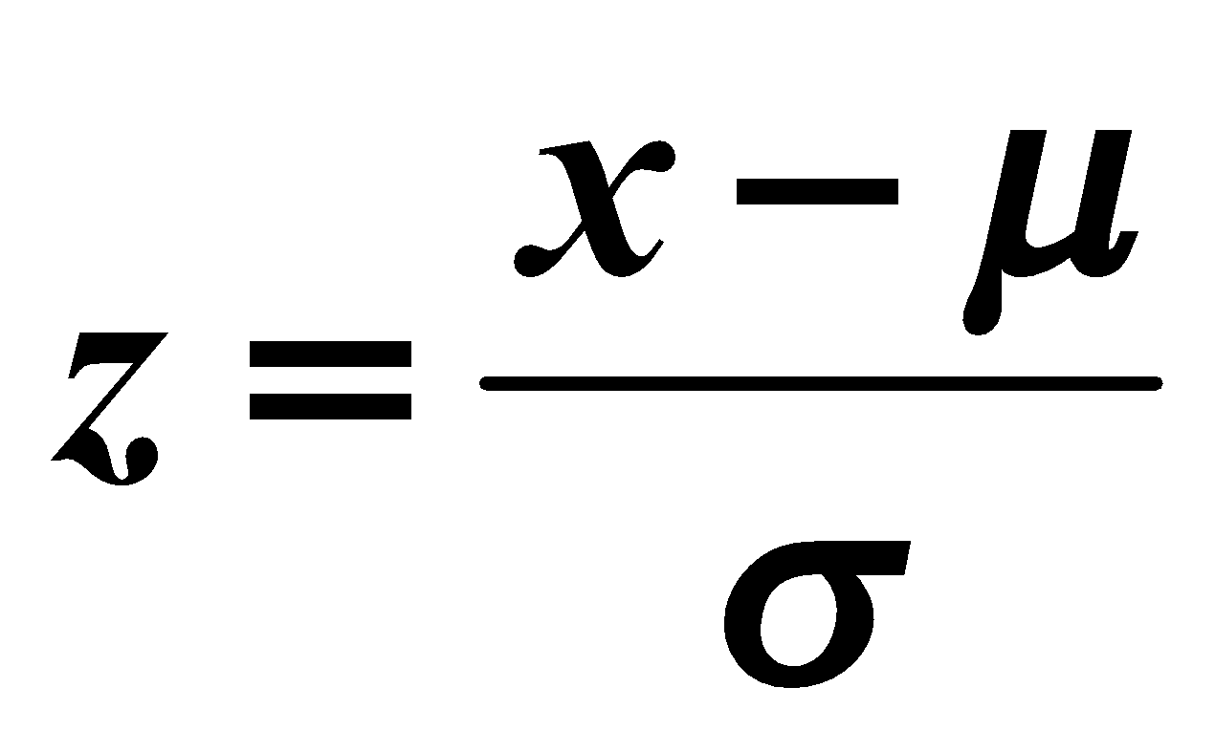
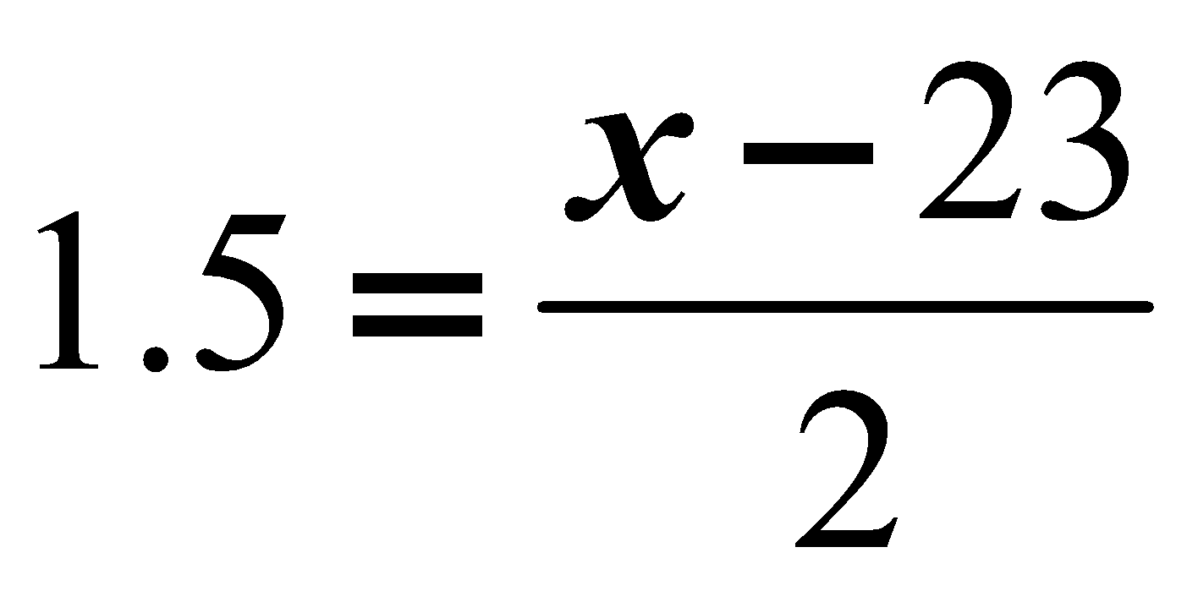
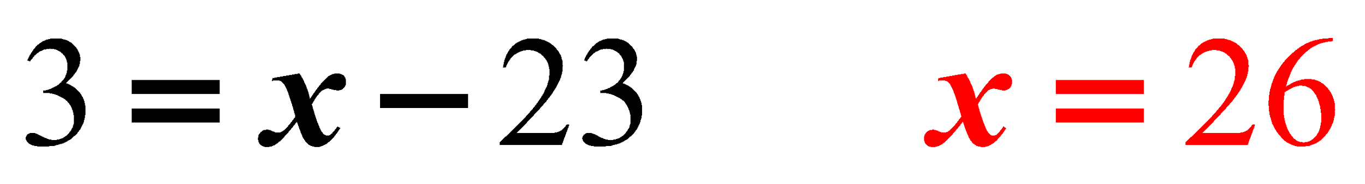
Analyzing the data
What will be the miles per gallon for a Toyota Camry when the average mpg is 23, it has a z value of 1.5 and a standard deviation of 2?
Using the formula for z-scores:
The Toyota Camry would be expected to use 26 mpg of gasoline.

Slide 29
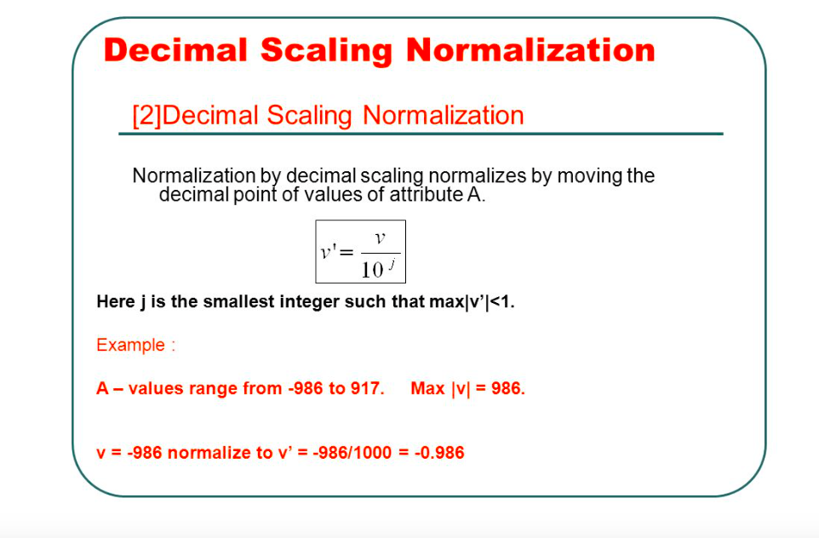
Analyzing the data

Slide 30
Data Reduction Strategy
Why data reduction?
A database/data warehouse may store terabytes of data
Complex data analysis/mining may take a very long time to run on the complete data set
Data reduction
Obtain a reduced representation of the data set that is much smaller in volume but yet produce the same (or almost the same) analytical results
Data reduction strategies
Data cube aggregation:
Dimensionality reduction — e.g., remove unimportant attributes
Data Compression
Numerosity reduction — e.g., fit data into models
Discretization and concept hierarchy generation

Slide 31
Data Cube Aggregation
The lowest level of a data cube (base cuboid)
The aggregated data for an individual entity of interest
E.g., a customer in a phone calling data warehouse
Multiple levels of aggregation in data cubes
Further reduce the size of data to deal with
Reference appropriate levels
Use the smallest representation which is enough to solve the task
Queries regarding aggregated information should be answered using data cube, when possible

Slide 32
Attribute Subset Selection
Feature selection (i.e., attribute subset selection):
Select a minimum set of features such that the probability distribution of different classes given the values for those features is as close as possible to the original distribution given the values of all features
reduce # of patterns in the patterns, easier to understand
Heuristic methods (due to exponential # of choices):
Step-wise forward selection
Step-wise backward elimination
Combining forward selection and backward elimination
Decision-tree induction

Slide 33
Example of Decision Tree Induction
Initial attribute set:
{A1, A2, A3, A4, A5, A6}
A4 ?
A1?
A6?
Class 1
Class 2
Class 1
Class 2
>
Reduced attribute set: {A1, A4, A6}

Slide 34
Heuristic Feature Selection Methods
There are 2^{d} possible sub-features of d features
Several heuristic feature selection methods:
Best single features under the feature independence assumption: choose by significance tests
Best step-wise feature selection:
The best single-feature is picked first
Then next best feature condition to the first, ...
Step-wise feature elimination:
Repeatedly eliminate the worst feature
Best combined feature selection and elimination
Optimal branch and bound:
Use feature elimination and backtracking

Slide 35
Dimensionality Reduction: Principal Component Analysis (PCA)
Given N data vectors from n-dimensions, find k ≤ n orthogonal vectors (principal components) that can be best used to represent data
Steps
Normalize input data: Each attribute falls within the same range
Compute k orthonormal (unit) vectors, i.e., principal components
Each input data (vector) is a linear combination of the k principal component vectors
The principal components are sorted in order of decreasing “significance” or strength
Since the components are sorted, the size of the data can be reduced by eliminating the weak components, i.e., those with low variance. (i.e., using the strongest principal components, it is possible to reconstruct a good approximation of the original data
Works for numeric data only
Used when the number of dimensions is large

Slide 36
Principal Component Analysis
X2
Y1
Y2
X1

Slide 37
Summary
Data preparation or preprocessing is a big issue for both data warehousing and data mining
Descriptive data summarization is need for quality data preprocessing
Data preparation includes
Data cleaning and data integration
Data reduction and feature selection
Discretization
A lot a methods have been developed but data preprocessing still an active area of research

Slide 38
Related Videos / Reference
D. P. Ballou and G. K. Tayi. Enhancing data quality in data warehouse environments. Communications of ACM, 42:73-78, 1999
T. Dasu and T. Johnson. Exploratory Data Mining and Data Cleaning. John Wiley & Sons, 2003
T. Dasu, T. Johnson, S. Muthukrishnan, V. Shkapenyuk. Mining Database Structure; Or, How to Build a Data Quality Browser. SIGMOD’02.
H.V. Jagadish et al., Special Issue on Data Reduction Techniques. Bulletin of the Technical Committee on Data Engineering, 20(4), December 1997
D. Pyle. Data Preparation for Data Mining. Morgan Kaufmann, 1999
E. Rahm and H. H. Do. Data Cleaning: Problems and Current Approaches. IEEE Bulletin of the Technical Committee on Data Engineering. Vol.23, No.4
V. Raman and J. Hellerstein. Potters Wheel: An Interactive Framework for Data Cleaning and Transformation, VLDB’2001
T. Redman. Data Quality: Management and Technology. Bantam Books, 1992
Y. Wand and R. Wang. Anchoring data quality dimensions ontological foundations. Communications of ACM, 39:86-95, 1996
R. Wang, V. Storey, and C. Firth. A framework for analysis of data quality research. IEEE Trans. Knowledge and Data Engineering, 7:623-640, 1995

